Slide 1
File Access

Slide 2
Objectives
This chapter introduces:
Read a file
Create a file

Slide 3
Modes for opening a file
"r“: Read (Default value)
Opens a file for reading, error if the file does not exist
"a“: Append
Opens a file for appending, creates the file if it does not exist
"w“: Write
Opens a file for writing, creates the file if it does not exist
"x“: Create
Creates the specified file, returns an error if the file exists
"t“: Text
Default value. Text mode
"b": Binary
Binary mode (e.g. images)

Slide 4
Read a file
Syntax:
Open and close:
f = open("FILENAME", "MODE")#Open file
#The default mode is reading the file
f.close()#Close file
Read a file:
A. f.read()#Return the whole text
B. f.readline() #Return one line that often has a ‘\n’ appended at the end
C. f.readlines() # Return all lines in the file, as a list where each line
#is an item in the list object, and each line often has a ‘\n’ appended
D. for counter in file :# Read data (string) through the file line by line
print(counter )

Slide 5
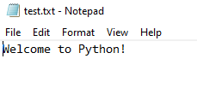

Read a file
E.g1:
Result:
#Read a specified file
name = input(" Please enter the file name: ")
# UTF-8 encoded
file = open(name, "r", encoding="UTF-8")
print(file.read() ) # Read the data
file.close()# Close the file

Slide 6
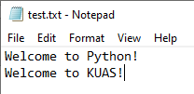

Read a file
E.g2:
Result:
file = open(“test.txt")#Open the specified file
print(file.readline() )#Read a line
file.close()#Close the file

Slide 7
Read a file
E.g3:
Result:
file = open(“test.txt")#Open the specified file
# Read data (string) through the file line by line
for counter in file :
print(counter )
file.close()#Close file

Slide 8

Read a file
E.g4:
Result:
array=[]#Define a list
file = open(“test.txt")#Open the specified file
array=file.readlines()
# Read data through the file line by line
for counter in array :
print(counter )
file.close()#Close file

Slide 9
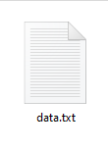
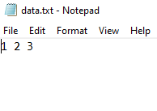
Create a file
E.g:
Result:
f1 = open("data.txt", "w")
print(1,2,3,file = f1)
f1.close()
#data.txt is the name of the output file
#”w” is the mode for opening the file

Slide 10
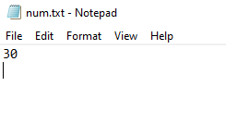
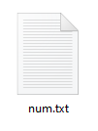
Create file
E.g:
Result:
num1=20#Integer variable 1
num2=10 #Integer variable 2
print(num1+num2, file = open("num.txt", "w"))
#num.txt is the name of the output file
#”w” is the mode for opening the file

Slide 11

Remove a trailing newline of a string
The readlines() or readline() function will keep the newline character
Sometimes, we need to delete the newline symbol for the display
E.g :
Output with extra newline symbol
Expected output

Slide 12
Remove a trailing newline of a string
E.g:
Result:
myfile = open("result.txt")#Read the file
for line in myfile.readlines():#Read all data in the file
#Delete the newline symbol and save it back
line=line.strip("\n")
print(line)
myfile.close()
The strip() method removes any leading (spaces at the beginning) and trailing (spaces at the end) characters (space is the default leading character to remove)

Slide 13
Read a file and Create a file
The following example
describes how to read the data,
put it in the list,
modify it according to the programmer’s needs,
then save the data back to the file

Slide 14
Read a file and Create a file
#--------------------------Read data--------------------------
file_in = open(“test.txt")#Read the specified file
arr=[]#Define a list
for line in file_in.readlines():#Display all data in the file
line=line.strip('\n')#Delete the newline
arr.append(int(line))#Insert it at the end of the list
print("Read data:")
for line in range(0,len(arr)):#Display the data in the list
print(arr[line])
file_in.close()#Close
#--------------------------Insert data-------------------------------
arr.append(100)# Insert 100 at the end of the list
print("Information after insertion:")
for line in range(0,len(arr)):#Display the data in the list
print(arr[line])
#--------------------------Output data-----------------------------
file_out = open(“test.txt","w")#Create the specified file
for line in range(0,len(arr)):#Write the data of the list to file
print(arr[line],file=file_out)
file_out.close()#Close
E.g:

Slide 15
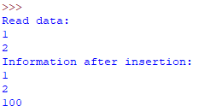
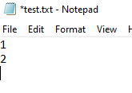
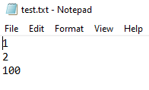
Read a file and Create a file
Result:
1. Original file information: 2. Data after execution:

Slide 16
Source
References:
http://openhome.cc/Gossip/Python/IOABC.html
http://www.pythondoc.com/pythontutorial3/introduction.html
http://pydoing.blogspot.tw/2011/01/python-operator.html
http://ithelp.ithome.com.tw/question/10161708
Python 深入淺出程式設計

Slide 17
Exercise 1
Design a program that allows the user to repeatedly select 1 or 2, until -1 is inputted.
When 1 is selected,
Display all the data stored in the text file, where each data is paired by a number and a text
When 2 is selected,
Allow to update the text by a specific number

Slide 18
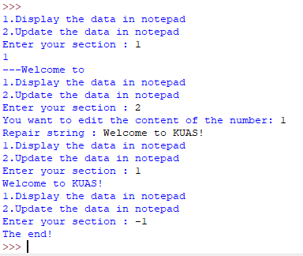
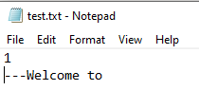
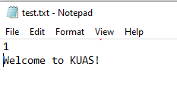
Example
Input:
Result:
1
2
1
Welcome to KUAS!

Slide 19


Exercise 2
Design a program that will ask the user to enter the names of input file and output file, and then print the data, which are from the input file but whose lower case letters are changed to upper case letters, to the output file
Input: Output:
input file: abc.txt
output file: xyz.txt

Slide 20
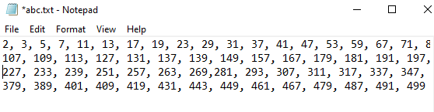
Exercise 3
Design a program that will ask the user to input an integer N, and then creates a file containing all the primes in the interval [0, N].
Input: Output:
N: 500

